Slide 1
OneSubsea Comments on “Aggregated vs Folder Discussion”
K. Bohle, M. Koenig, T. Marwedel

Slide 2
“During the meeting the participants on the call seemed to feel that folders are best for representing fields, XTs and other large subsea structures.“
[Email Rachael Mell from 22-Jun-2017]
We do not agree with the statement above. Folders are a viable solutions for representing fields/XTs but also have some limitations which are highlighted on the following slides

Slide 3
Metadata
A Folder is a generic OPC-UA defined object and can’t have any MDIS defined standard information. This includes:
TagID
Enable Status
Faults
Warnings
Interlocks

Slide 4
TagID
A Folder offers no dedicated location to store the TagID
When an operator provides a tag list this information can only be stored in the “BrowseName” of the Folder
Our experience in real projects has shown that the final TagID list is never available when a project starts and that the information can change frequently
As a result the “BrowseNames” and the Nodeset files can also change frequently and might contain dummy data if no TagID is known
For Aggregated Objects the “BrowseName” won’t be affected by changes of the TagIDs

Slide 5
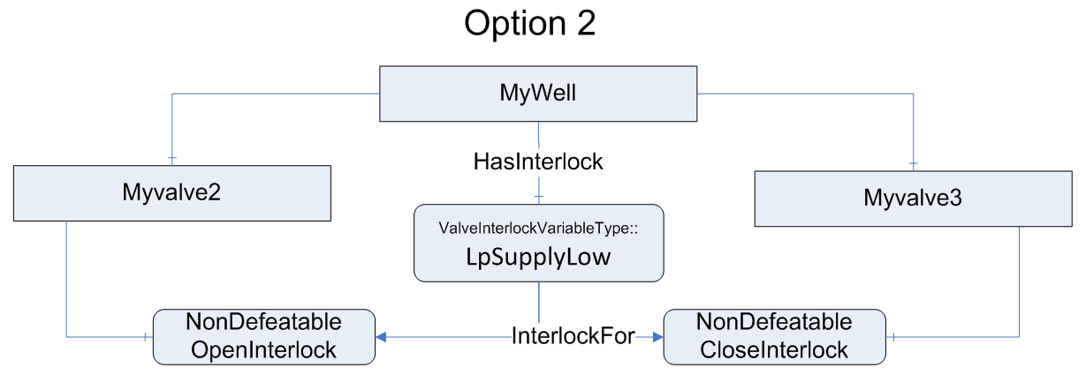
Interlocks
A Folder can’t have any Interlock variables.
If we decide that wells can only be represented as folders implementations like the figure below would be impossible
We had a very long discussion about this topic and at the end the group voted to support Option 2 which is also reflected in the released Companion Spec.

Slide 6
Testing
Folders do not qualify for model-based testing
Folders can’t be compared. If we have a Folder XT1 and XT2 we don’t know if these are of the same type or totally different.
On the other hand Aggregated Objects have their own NodeID and offer the possibility of model based testing which will reduce the overall engineering effort

Slide 7
Conclusion
There is no option which is generally better for all vendors and projects.
Folders are easier to create but offer less room for standardization
Aggregated Objects require more effort in the initial creation phase but will reduce engineering and test efforts in later stages

Slide 8
Recommendation
Add a requirement to the Companion Spec. that a Folder based hierarchy has to be supported by all Vendors
A hierarchy based on Aggregated Objects can be used if this is agreed by Subsea and DCS Vendors
Add an entry to the “MDIS Project Checklist” to select the intended hierarchy for a given project

